Slide 1
JENKINS

Slide 2
Jenkins is a powerful application that allows continuous integration and continuous delivery of projects, regardless of the platform you are working on. It is a free source that can handle any kind of build or continuous integration

Slide 3
Before Jenkins | After Jenkins
The entire source code was built and then tested. Locating and fixing bugs in the event of build and test failure was difficult and time-consuming, which in turn slows the software delivery process. | Every commit made in the source code is built and tested. So, instead of checking the entire source code developers only need to focus on a particular commit. This leads to frequent new software releases.
Developers have to wait for test results | Developers know the test result of every commit made in the source code on the run.
The whole process is manual | You only need to commit changes to the source code and Jenkins will automate the rest of the process for you.

Slide 4
Jenkins is a software that allows continuous integration. Jenkins will be installed on a server where the central build will take place. The following flowchart demonstrates a very simple workflow of how Jenkins works
Developers check their source code
Jenkins will pick up the changes source code and trigger a build and run any tests if required
The build output will be available in the Jenkins dashboards. Automatic notifications can also be sent back to the developer

Slide 5
Type in the following plugins in the Filter search bar and select them:
Blue Ocean (to visualize in details the Pipeline workflow)
Configure File Provider (to add your customized maven settings file to Jenkins)
Docker
Git
Maven Integration
Pipeline (set of tools for modelling scripted Continuous Deployment Pipelines in Jenkins)
Pipeline Maven Integration
Click Install without restart to install all plugins at once without restarting the Jenkins server.

Slide 6
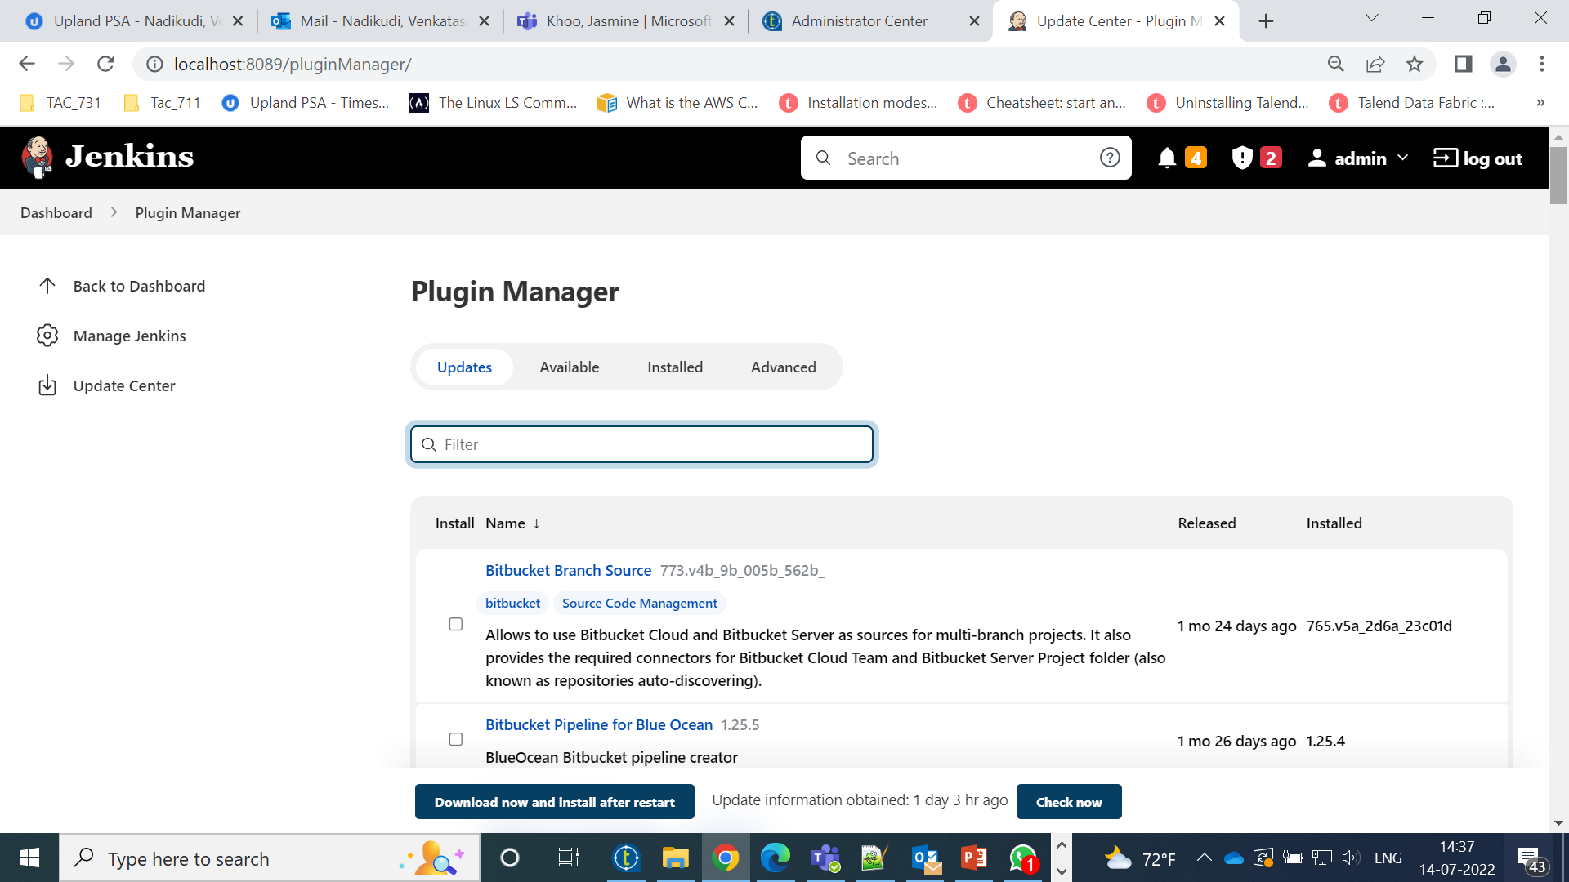

Slide 7
